Slide 1

Telephone Switching TS Fibersource Overview

Slide 2
Telephone Switching and TS Fibersource Overview
Telephone Switching International and TS Fibersource have been supporting the Telecom Industry since 1978. We offer a wide variety of products and services with competitive pricing and fast delivery
Based in Milan Tennessee with locations around the country, TSI and TS Fibersource stand ready to support your Telecom product and service needs

Slide 3
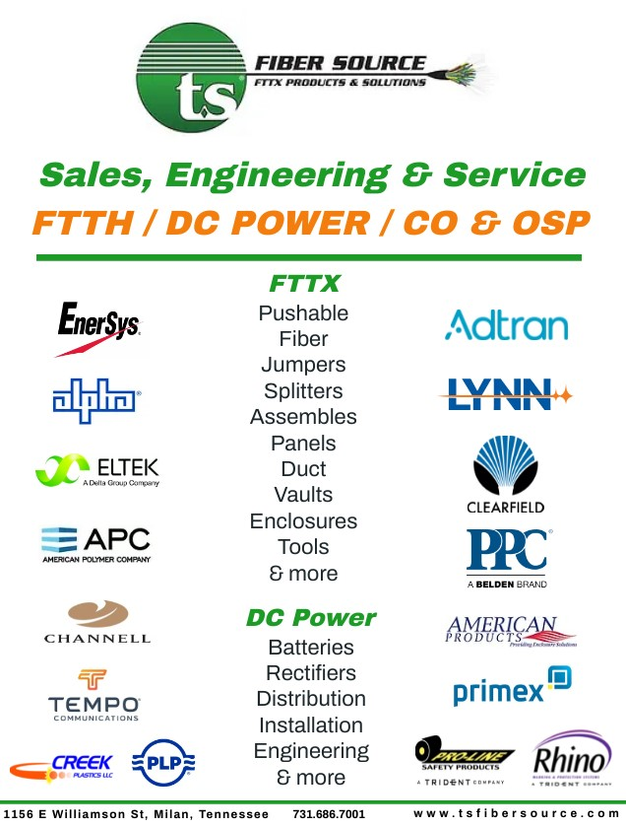

Slide 4


Slide 5


Slide 6

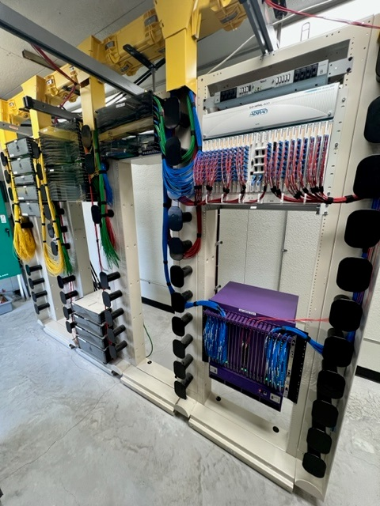
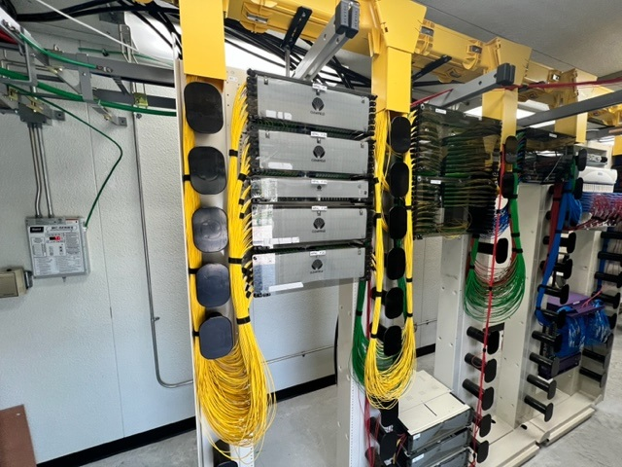

Slide 7
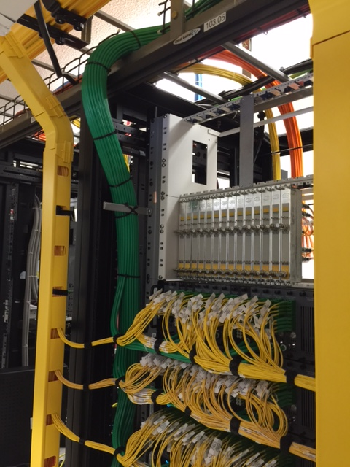
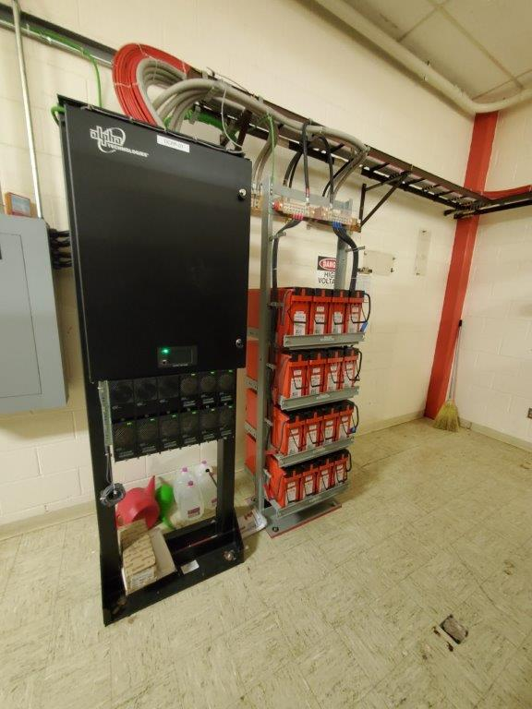
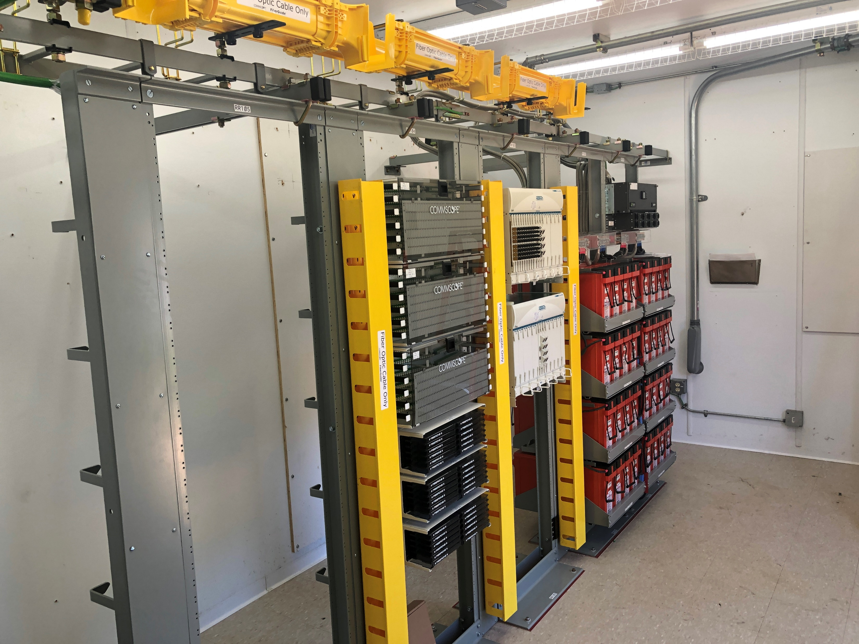
Recent Installations

Slide 8
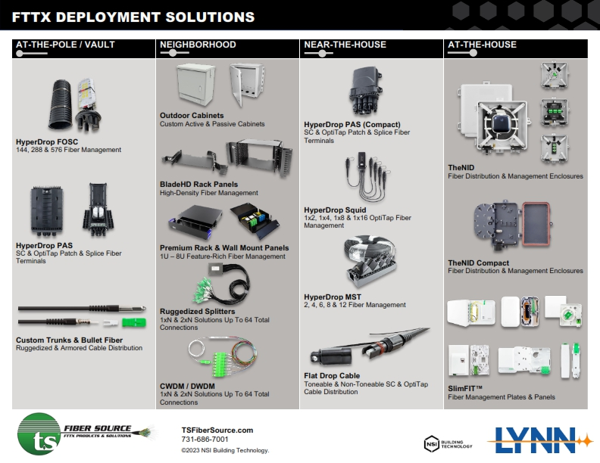

Slide 9
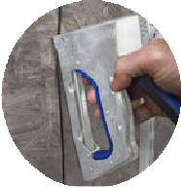




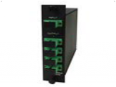
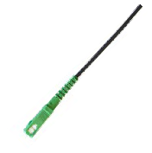
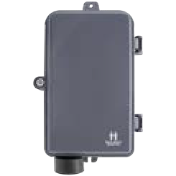
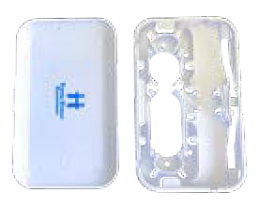
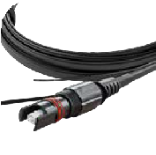
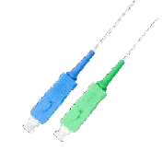

FTTX Products
FDH BOX
FIBER OPTIC SPLITTERS
Available in LGX, Rackmount and Inline formats
Designed for high density cabling environment
Silk screened port number for easy identification
Fits standard distribution or network cabinet
INDOOR/OUTDOOR RUGGEDIZED
PATCH CABLE
Corning® Clearcurve™ SMF-28 Ultra BIF
Ruggedized, designed to install with staples
Meets water penetration requirements of Telcordia
Passed Verizon TPR 9424 Issue 2 60 staple test
Custom lengths, ships in 2-3 days
GR-20-CORE
FIBER DISTRIBUTION TERMINAL
Accommodates select PLC splitters or loaded fiber
SLIMFIT™ CUSTOMER CONNECTION POINT
Aesthetic appearance includes a white gloss finish
Suitable for indoor use in residence or office
Easily store excess cable inside enclosure or outlet
Fast installation. Mounts directly single gang low-voltage bracket or outlet box.
pigtails using fusion splicing
Constructed of the highest quality industrial plastic
Designed for the harshest outdoor elements, IP65
Aesthetic appearance includes a glossy finish
Suitable for wall mounting to building
Optional company logo silk screening available
OSP FTTx DROP CABLE
OptiTap® Compatible*
Ruggedized SC APC & SC UPC connectors available
Designed for direct burial, duct, & self-supporting installations
Water Blocking Aramid Yarn
Custom lengths, ships in 2-3 days
Flat Drop cable style available
FIBER DEPLOYMENT PATCH CABLE
SC APC to SC UPC Corning® Clearcurve™ SMF-28 Ultra BIF
Available in brilliant white for in-home aesthetic
Fiber keystone jack & wall plate available
LYNN, Inc. is not affiliated with Charles Industries, Clearfield, Inc., Corning, Inc., Panduit, Leviton Manufacturing Company, Inc., US Conec, Ltd., or Velcro BVBA.
All Charles Industries, Clearfield, Corning (including OptiTap®), Panduit, Leviton, and Velcro product names are trademarks or registered trademarks of Corning, Inc., Panduit, Leviton Manufacturing Company, Inc., and Velcro BVBA respectively.
MTP® is a registered trademark of US Conect, Ltd.
All products are available as pictured in this document. Some products displayed may include optional equipment.

Slide 10
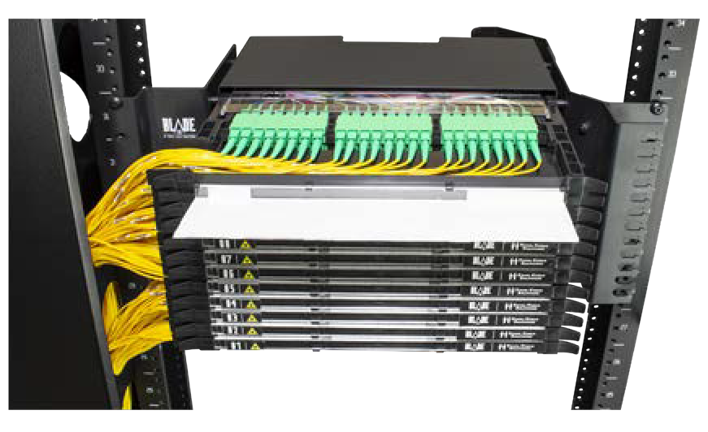
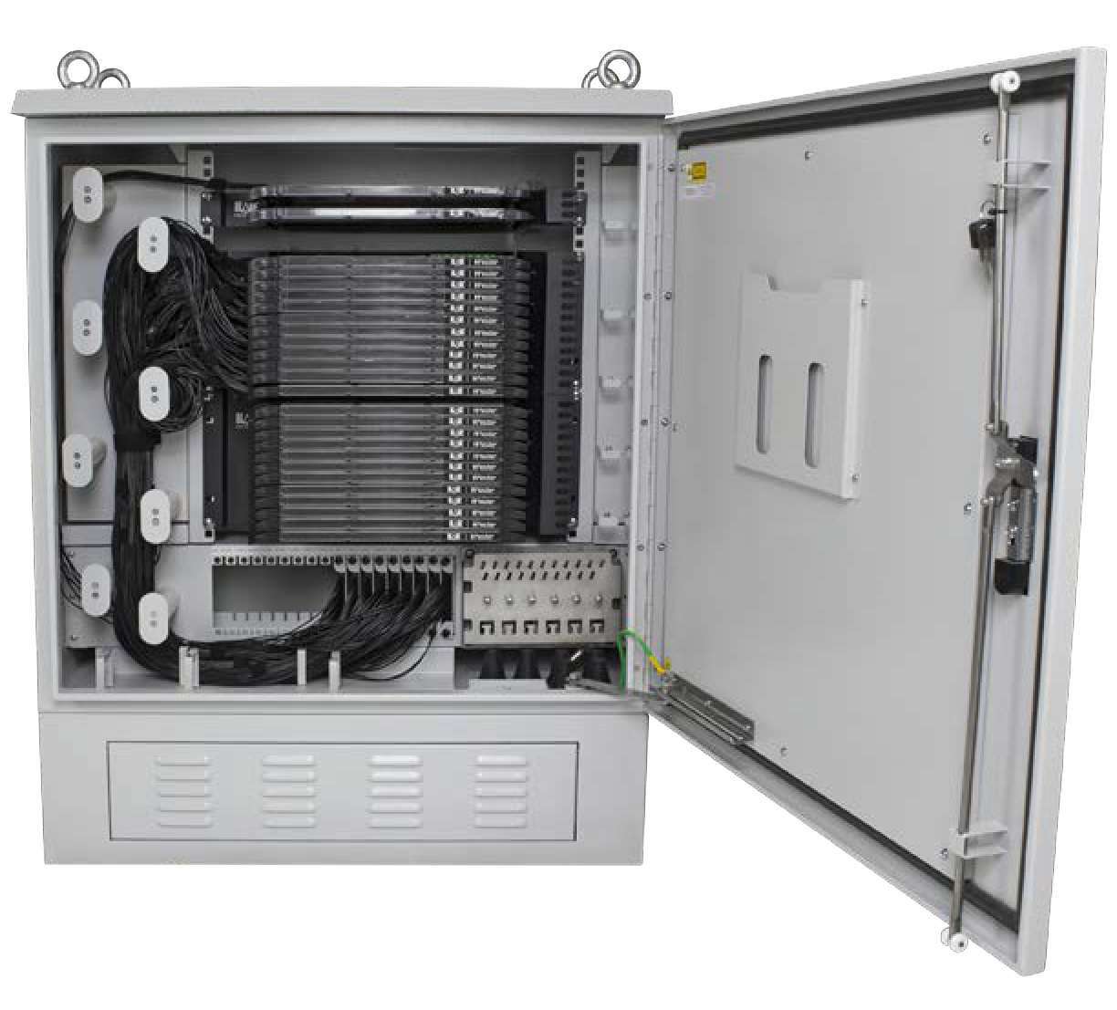
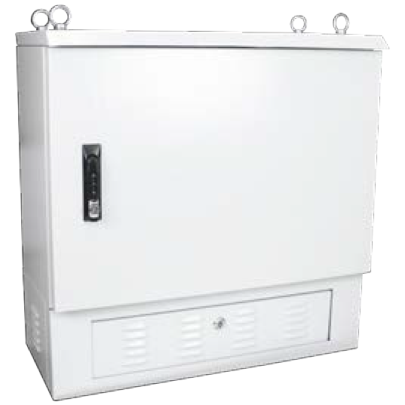
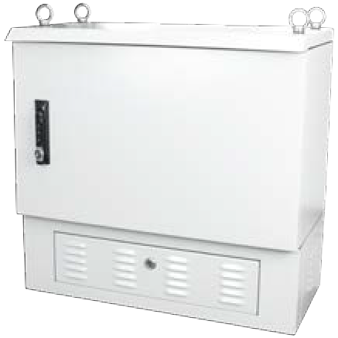
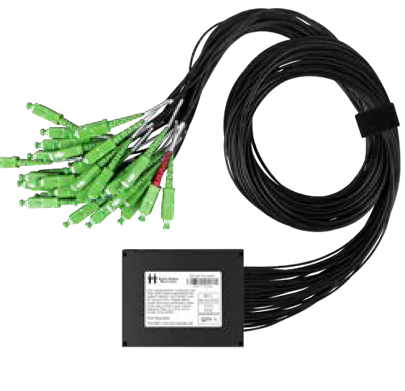

576 SC Fiber BladeHD Outdoor Splitter Cabinet (FDH)
OCB-BHDFDH-SAxxx-11U
288 SC Fiber BladeHD Outdoor Splitter Cabinet (FDH)
OCB-BHDFDH-SAxxx-04U
144 SC Fiber BladeHD Outdoor Splitter Cabinet (FDH)
OCB-BHDFDH-SAxxx-08U
Designed for BladeHD™ Outdoor Splitter Cabinet (FDH).
Ruggedized Splitters with SC/APC termination
Designed for outdoors and extended temperatures
FEATURE
BladeHD Ruggedized Fiber Splitter
(SC APC)
FS-RR-132-GH-SASA-M
CONFIGURATION TYPES:
1x2, 1x4, 1x8,1x16,1x32,2x2, 2x4, 2x8,2x16,Multiple 1xN available
(888) 235-2097

Slide 11

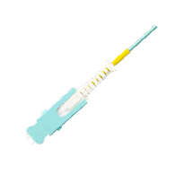

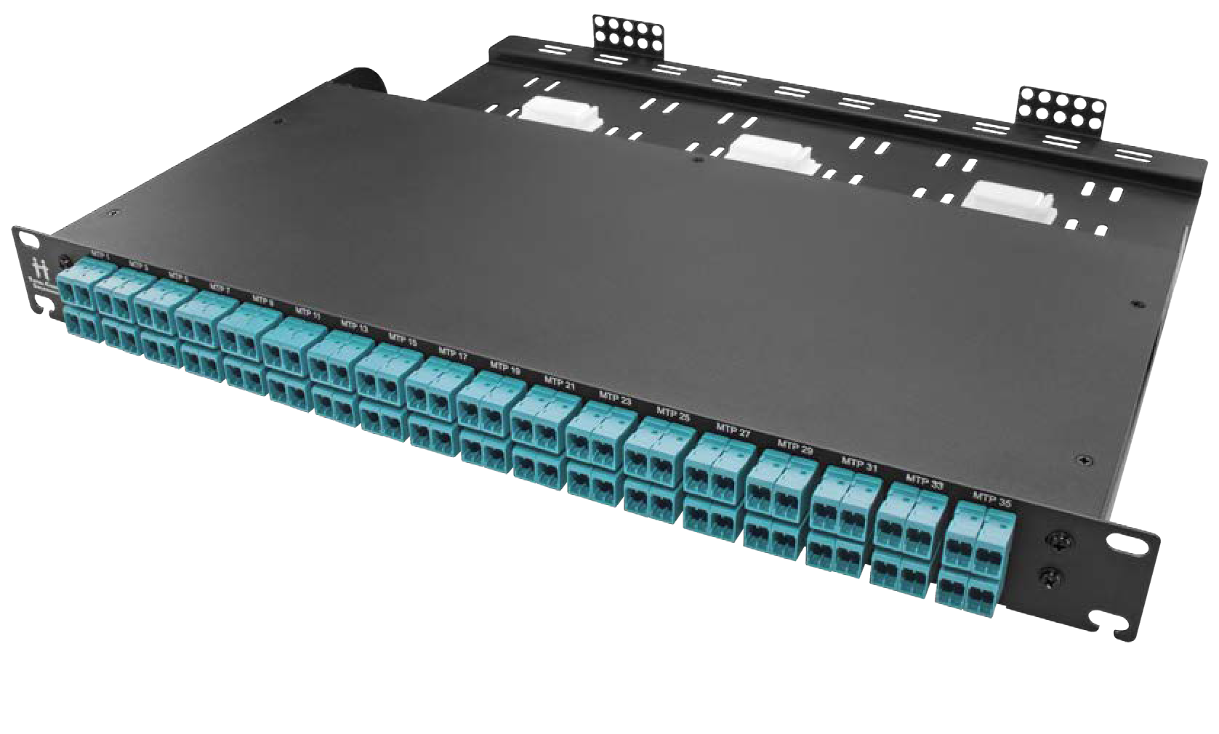
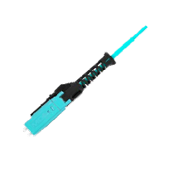

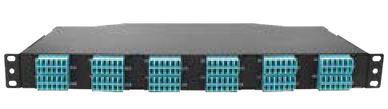









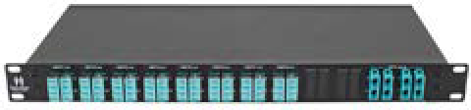
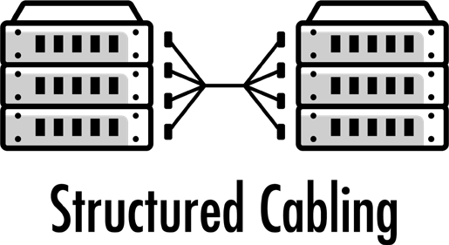


FEATURE
SN
MDC
OptimusMAX 288
SN or MDC
PAN-144Mx-xxx
Use SN-LC or MDC-LC patch cords to
DATACOM
3X
connect to existing data center equipment
FIBER DENSITY!!!
vs Standard LC Duplex Connector
OptimusMAX 216
PAN-108ML-xxx
OptimusMAX 192
PANV-96ML-xxx
OptimusMAX 144 Available Flat or Angled PANx-72ML-xxx
OptimusMAX Rear Cable Manager
PAN-CBL-MGR-SHELF
HIGHLY ADAPTIVE
Provides a wide variety of configurations for your patching needs
COST EFFECTIVE
Simple rackmount design eliminates the need for individual cassettes
HYPERSCALE READY
Scalable solution for port breakout, replication or pass through
Optimus 96
PAN-48ML-xxx
Optimus 72
PAN-36ML-xxx
Optimus 48
PAN-24ML-xxx
Optimus QSFP 96
QSFP to SFP Distribution Panel
QSFP-DPAN-48ML-xxx
Optimus QSFP 64
QSFP to SFP Distribution Panel
QSFP-DPAN-32ML-xxx
Optimized for Your Application!

Slide 12
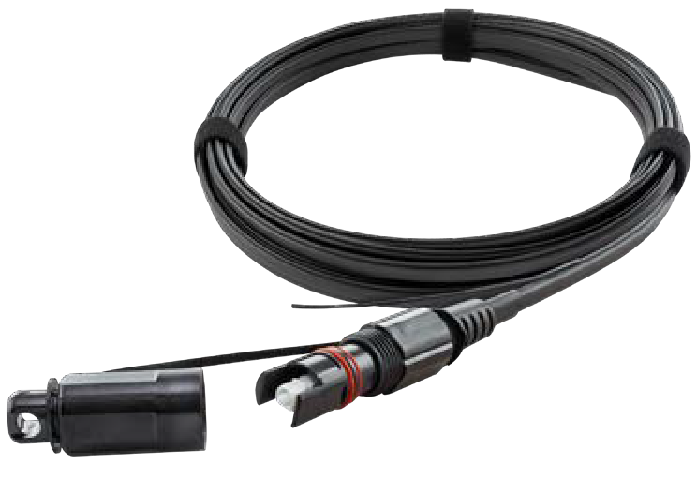
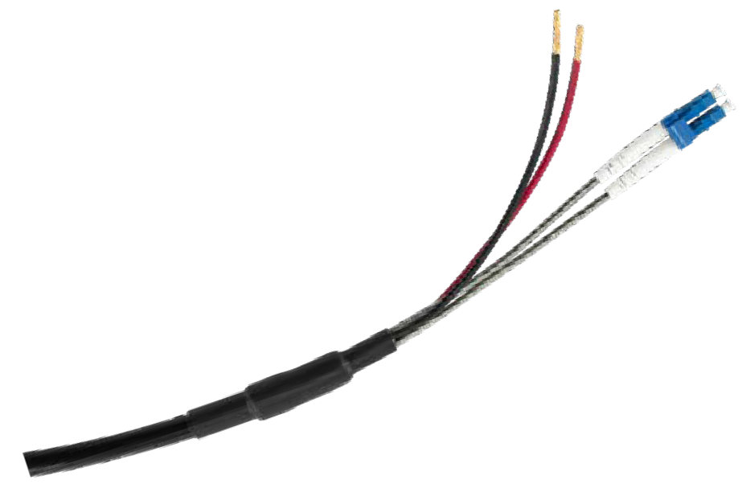

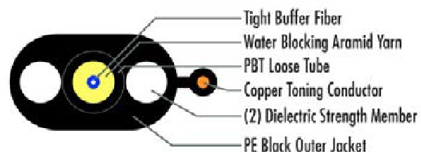
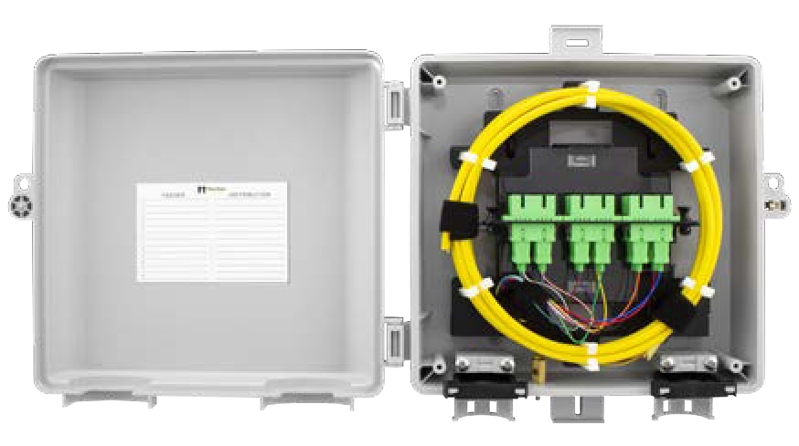
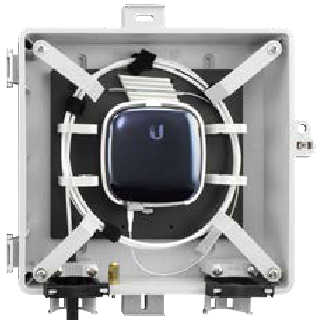
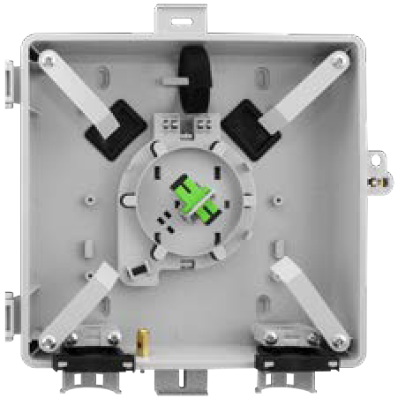
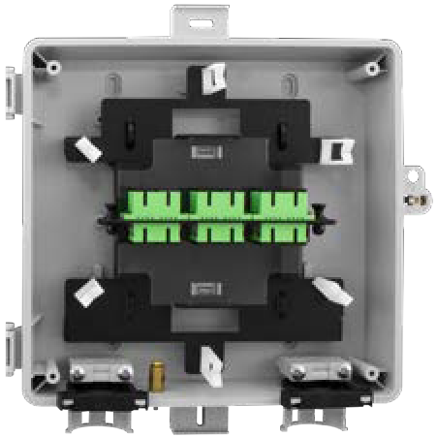
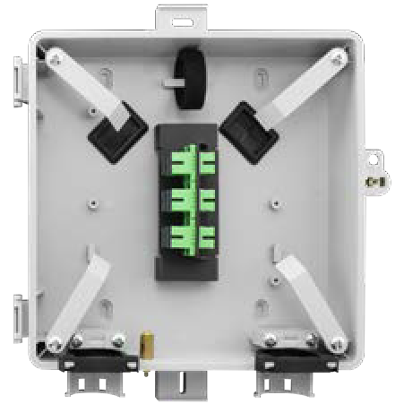
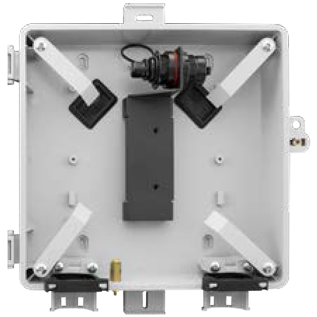
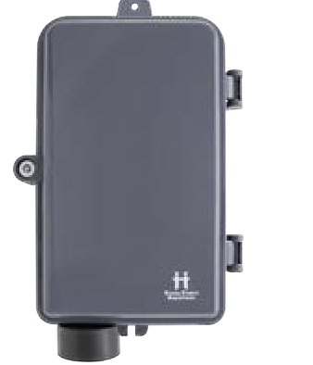
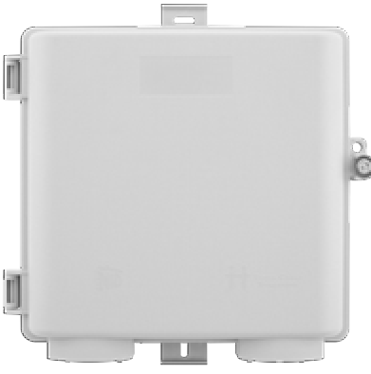
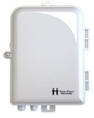
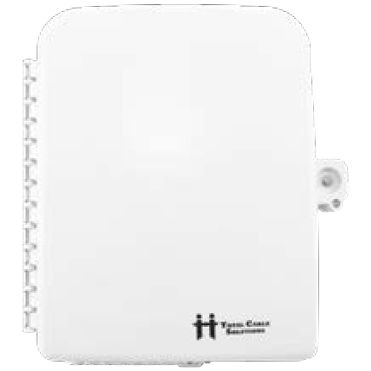
Designed for long distance/high power.
FiPOW Indoor/Outdoor Hybrid Cable
(Fiber with copper conductors)
Available 1-24 Fiber, 2-16 conductors, 12 or 16 AWG
Flat Drop Toneable Cable
with H Connector (OptiTap® Compatible)
MST-OA1xx-01ST-AxxxF
FIBER ENTRY TERMINALS
FEATURE
A compact Fiber Entry Terminal (FET) designed for flat and round drop cable entry and the harsh conditions in Outside Plant.
Designed for flat and round cable entry
(variable clamp entry securely holds both round and flat drop cables)
Accepts up to 1-inch conduit
Electrical copper ground lug included
TheNID - ONT
FPP-TN-M-93
TheNID - Splice
FPP-TN-A-86
TheNID - Splice Duplex
FPP-TN-AD-86
TheNID - LGX
FPP-TN-E-85
TheNID - Patch
FPP-TN-L-88
TheNID - Hardened
FPP-TN-T-89
Compact NID
FPP-6S-W-15
TheNID
FPP-TN-x-xx
16 SC NID
FPP-12S-W-16
24 SC NID
FPP-24S-W-94

Slide 13
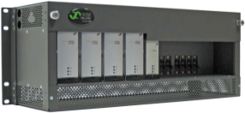
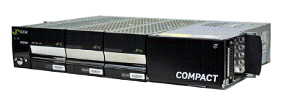

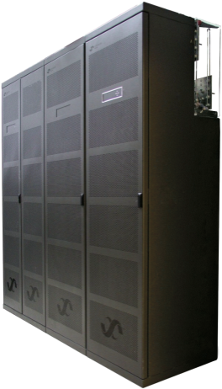
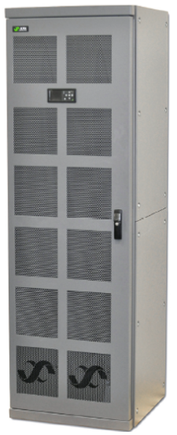
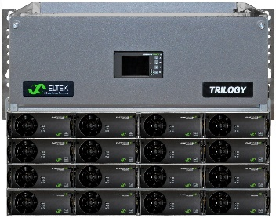
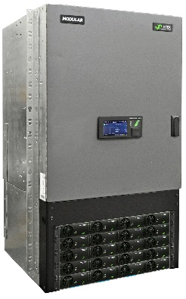
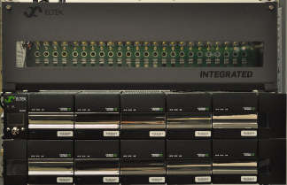
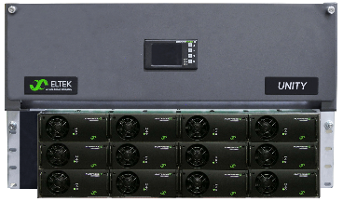


DC Infrastructure Systems 200 – 20,000 Amps
OUTPUT VOLTAGES
48VDC, 24VDC, 380VDC
INTELLIGENT CONTROL SYSTEMS
MICROPACK
FLATPACK-S
COMPACT
0 AMPS
SMALL CAPACITY SYSTEMS
INTEGRATED
200-500 AMPS
TRILOGY SPS
UNITY
MEDIUM CAPACITY SYSTEMS
MODULAR
600 AMPS
ECO TOWER
SCALABLE
LARGE CAPACITY SYSTEMS

Slide 14
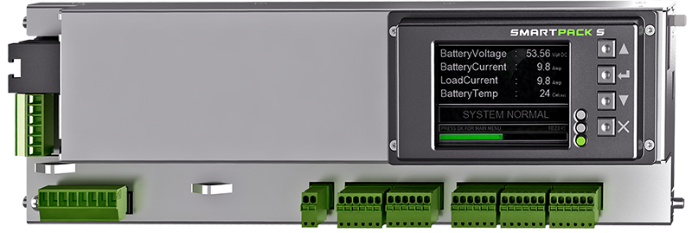
CONTROLLER
UNITY POWER SYSTEM
HTTPS, FTPS, SNMP v1, v2c, v3, MODBUS TCP/IP, MODBUS RTU, SMTP (email), SNTP (timeserver), and RADIUS
Modbus RTU port (RS232 or RS485) for communication to external devices such as Lithium Ion Batteries
Secure firmware upgrades through the Eltek Network Utility (ENU) or secure FTP
Backup configurations with Change Log to XML via the web interface
Smartpack S Panel Mount

Slide 15


Notes:
ALM – name, not acronym

Slide 16
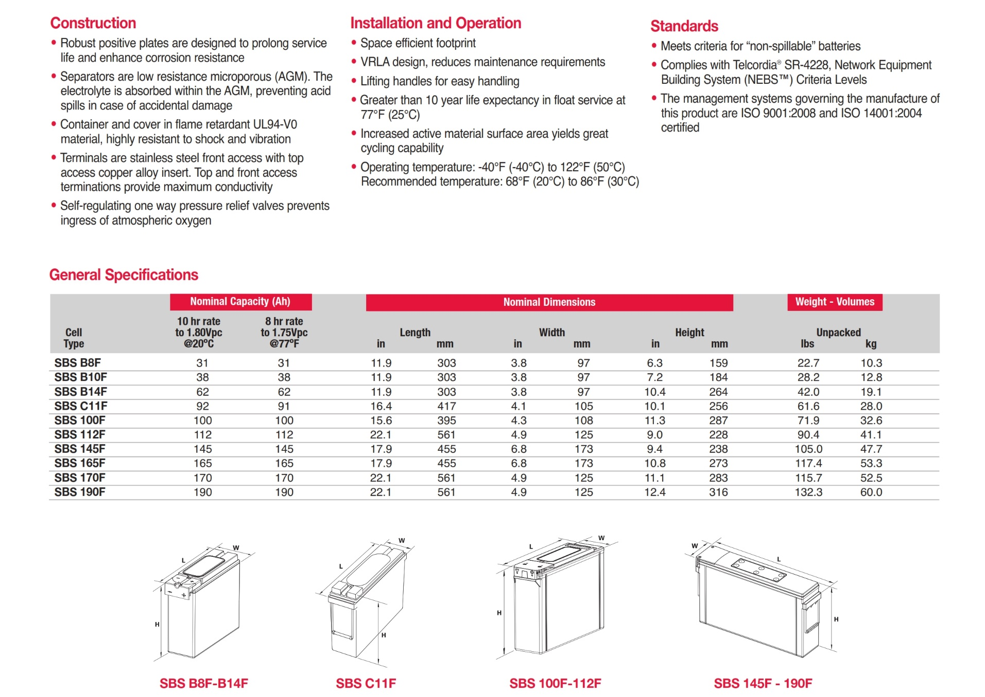
Notes:
ALM – name, not acronym

Slide 17
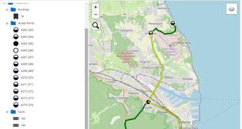


What is ALM?
overview
End-to-end fiber monitoring solution
Detects faults and security intrusions
Proactive; meets urgency requirements
No privacy concerns
GUI interface delivers information
Notes:
ALM – name, not acronym

Slide 18
Key points
16 Port
64 Port
Fastest fault detection time
Low maintenance solution
Fiber integrity measurement takes 2 to 5 seconds only, accurate within 3 meters
  No regularly-required service; high reliability
Compact footprint
Full-fledged north-bound interface
  With 64 ports in 1RU the ALM is the densest solution with lowest power consumption
  The ALM offers an extensive NBI and is integrated in many GIS and Adtran NM

Slide 19
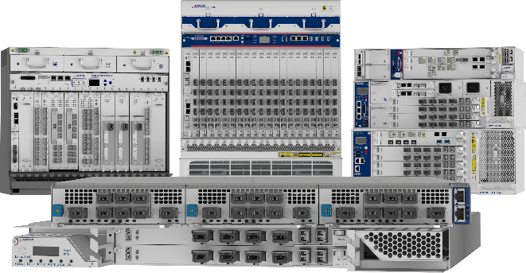
ADTRAN/ADVA
FSP 3000 open optical transport/DWDM
  Open optical networking solutions based on wavelength division multiplexing (WDM) technology to deliver scalable bandwidth for access, metro and long-haul networks
    Future Proof optical networks
    Secure connectivity
    Automation and ease of use

Slide 20





Flexible deployment
Chassis sizes from 1RU to 12RU
Front and rear access variants
ETSI 300mm / 600mm depth options
AC / DC power
Fully redundant configurations
E+Temp for outdoor deployment
4RU shelf with 7 traffic slots
Rear power access
2RU ETSI shelf with 4 traffic slots
(OLS-optimized shelf)
1RU shelf with 2 traffic slots.
Rear power and mgmt. access
12RU ETSI shelf with 20 traffic slots; all front access
Sample of FSP 3000 shelves
Hardened temperature 1RU shelf (-40°C to 65°C; 5 to 85% rel. humidity)
For any type of traffic module (muxponders, amplifiers, etc.)
Well suited for metro-access nodes in street cabinets
E+Temp shelf with 2 traffic slots. All front access

Slide 21




FSP 3000 open optical terminals
Open trans-/muxponders cards
  Compact cards offering multi-rate, multi-service support, with pluggable optics, and up to
  400Gbit/s transport capacity.
  Application-optimized card variants. Card variants with quantum-safe layer 1 encryption
FSP 3000 TeraFlex™
  Chassis-based optical terminal offering 7.2Tbit/s capacity in just 1RU, for the
  transport of 10G, 100G and 400G Ethernet services and up to 800Gbit/s line speeds
FSP 3000 TeraFlex™
FSP 3000 OpenFabric™ Series
  Series of switchponder cards integrating an open and flexible OTN fabric for efficient
  OTN traffic grooming
FSP 3000 OpenFabric™ Series
Notes:
Compact trans-/muxponder cards offering multi-rate, multi-service support, pluggable optics, and up to 400Gbit/s transport capacity
OpenFabric™ Series integrating an open and flexible OTN fabric for efficient OTN traffic grooming
FSP 3000 TeraFlex™ integrated optical terminal offering 7.2Tbit/s capacity in just 1RU, for the transport of 10G, 100G and 400G Ethernet services and up to 800Gbit/s line speeds
Trans/Muxponder variants with our standardized and certified ConnectGuard™ optical encryption technology with post-quantum cryptography (PQC) and Quantum Key Distribution (QKD) support

Slide 22

Master Clock What is OSA synchronization and timing?
OVERVIEW
OSA – Oscilloquartz
Secure, accurate timing
More accurate than generic NTP internet timing
Redundancy ensures accuracy through layers
Resilient against spoofing and jamming
Resilient against signal loss (hold-over timing)
More secure than UDP protocol

Slide 23





Unique benefits of OSA
  Ensure the strength of your NTP hierarchy
  Client-server model
  UDP communication
  Resilience with redundant servers
  Prevents accuracy deterioration through layers
  Integrity is protected by hashing
  Prevent vulnerability against DoS and man-in-the-middle attacks

Slide 24

Meet the Adtran SDX 6324
The small OLT that delivers big things
Notes:
It is my great pleasure to introduce the latest addition to our disaggregated OLT family, the SDX 6324.
It is a compact, 4-port, rack-mountable addition to our portfolio

Slide 25
Introducing the industry’s smallest Combo PON OLT
The small olt that delivers big things
Technical specifications | Uplinks
PON ports | Four Combo PON (GPON+XGS-PON)
Uplinks | 4x 10GbE SFP+
Subscribers | ~500 (up to 1:128 split)
Dimensions | 235 x 381 x 44mm (1RU) (D x W x H)
Airflow | Front / side (left) to side (right)
Weight | 8.8lbs / 4kg
Temperature range | -40°C to 65°C (temp-hardened)
Powering | -48VDC redundant feed
Typical power consumption | 95W (-48VDC at 25°C w/o optics)
Compact and power-efficient, our SDX 6324 addresses the key challenges of established, emerging and migrating service providers. It’s the ideal solution for low-density FTTH deployments.
1-4 combo PON SFPs
Power, alarm, USB, management
4x 10GbE
Notes:
The interfaces can be used as
Downlinks to other SDX OLTs so you can stack them into a larger logical OLT.
They can be used as a 10GigE UNI for P2P services.
Or broken out using our MicroMux Nano product to provide ten 1GigE interfaces on each port.
And the final component is the field-replaceable fan tray which is the only moving part
The SDX 6324 is the most compact Combo PON OLT on the market.
It weighs only 4kg or 8.8lbs for easy installation for a single person.
At only 95 watts of power, this remarkable device can deliver multi-gig services to more than 500 households using less power than a light bulb.

Slide 26


Simplicity in a box
Open, disaggregated olt
Ctrl
Agg
Line card
  Self-contained compact OLT appliance
  100 to 6,000 customers per appliance
  Deploy as stand-alone or part of a system
  Scales as a system with current deployments
  Capable of serving 100,000 subs in a single OLT
  Plug-and-play deployment and replacement
  Very basic skills needed to deploy
Simple installation – Simple inventory management – Simple replacement and upgrade
Notes:
Taking things a step further, we are also seeing the drive for consolidated functions where an PON OLT shelf historically could only be utilized for FTTH access, we are now able to consolidate other functions into these OLTs so that even less equipment is needed to deliver services to consumers.
We can leverage optical components to fractionalize high speed Ethernet interfaces into multiple lower speed interfaces, allowing many direct Ethernet applications to be serviced off each compact OLT.
We are able to utilize coherent transceivers and coloured optics to eliminated the need for additional WDM transponder equipment, instead embedding that function directly into the OLT, and finally we have the capability to disaggregates some of the key features of a typical BNG device and spread that across the components of a disaggregated OLT permitting for many operators the complete elimination of dedicated, resource hungry BNG appliances.

